Slide 1
Implementation Notes PALISADE Library Homomorphic Cryptography For Programmers, By Programmers
NJIT Cybersecurity Research Center
Jerry Ryan
gwryan@njit.edu

Slide 2
Principles
Do not require deep expertise in homomorphic cryptography to use the library
Provide a framework for experimenting with all levels of implementation
Be straightforward for programmers to use

Slide 3
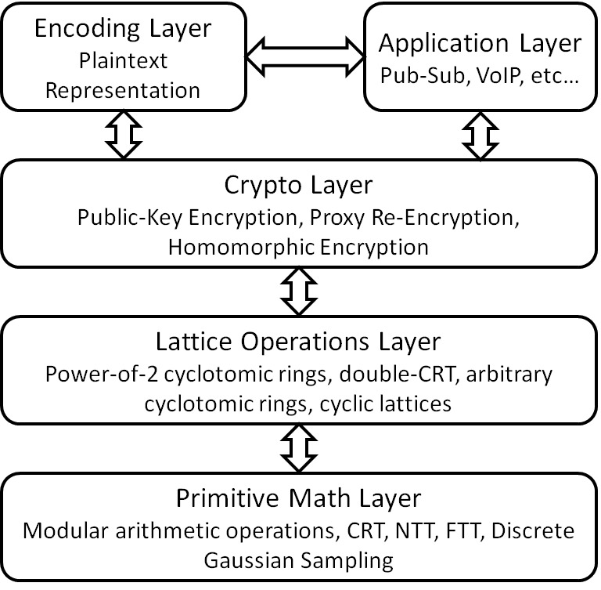
PALISADE Architecture
Multiple Encodings
Multiple schemes
Several options

Slide 4
Each Layer Provides…
A mechanism to choose a particular implementation for a given layer, and a guideline for providers of new implementations
Example: Victor Shoup’s NTL library was integrated into PALISADE with a thin wrapper layer
Able to – and interested in – integrating hardware accelerators
Interface specification (class definitions)
Prototypes for operations to be implemented
C++ operator overloads
Example: Eval Mult is implemented as an overload of operator* for pairs of Ciphertexts, or for a Ciphertext and a Plaintext

Slide 5
CryptoContext
Container for all crypto operations
Factory methods by scheme, with parameters set at construction time
All operations (encryption, decryption, homomorphic operators) are CryptoContext methods
Parameter checking and type safety provided
Provides factory methods for all crypto objects (Plaintext of various types, Ciphertext, RationalCiphertext, and matrices)
Simple initialization and straightforward serialize/deserialize operations

Slide 6
Crypto Schemes
A variety of schemes are supported
LTV
StSt
BGV
(B)FV, BFVrns
Null (test scheme)
Individual features (Encryption, FHE, SHE, etc) are enabled/disabled at run time

Slide 7
Creating a CryptoContext
CryptoContextFactory methods exist for each crypto scheme
Create the context from passed parameters
Generate parameters for the context based on constraints (desired security level, depth of operations)
Create a new context from a previously serialized context or other crypto object

Slide 8
Creating a New Scheme?
Create new subclass definitions for your scheme
Build implementations for supported methods
Provide new CryptoContextFactory method(s)

Slide 9
What’s a Null Scheme?
Useful testing platform
All keys are elements full of zeroes
Encrypt/Re-Encrypt/Decrypt are simply copies
EvalAdd is mod p element-wise add
EvalMult is mod p convolution

Slide 10
Element
Library classes are currently templated based on type of the underlying data elements
Poly
NativePoly
DCRTPoly

Slide 11
Basic Operations
Key Generation
Re-Encryption Key Generation
Encrypt
Decrypt
ReEncrypt
EvalAdd
EvalMult
…

Slide 12
Example Usage
CryptoContext<Poly> cc = CryptoContextFactory<Poly>::genCryptoContextFV(…);
cc->Enable(ENCRYPTION);
// Perform the key generation operation.
LPKeyPair<Poly> kp = cc->KeyGen();
// Encryption
Plaintext ptxt = cc->MakeIntegerPlaintext(42);
Ciphertext ctxt = cc->Encrypt(kp.publicKey, ptxt);
//Decryption
Plaintext ptxtNew;
DecryptResult result = cc->Decrypt(kp.secretKey, ctxt, &ptxtNew);

Slide 13
Example Usage
cc->Enable(ENCRYPTION);
cc->Enable(SHE);
LPKeyPair<Poly> kp = cc->KeyGen();
cc->EvalMultKeyGen(kp.secretKey);
Plaintext p1 = cc->MakeCoefPackedPlaintext({12,32,17,4});
Plaintext p2 = cc->MakeCoefPackedPlaintext({12,5,12,18});
auto c1 = cc->Encrypt(kp.publicKey, p1);
auto c2 = cc->Encrypt(kp.publicKey, p2);
auto ans = c1 * (c1 + c2);
//Decrypt and print the answer
Plaintext ptxtNew;
cc->Decrypt(kp.secretKey, ans, &ptxtNew);
cout << ptxtNew << endl;

