Slide 1
Reinforcement Learning for
Complex System Management
David Wingate
wingated@mit.edu

Slide 2
Complex Systems
Science and engineering will increasingly turn to machine learning to cope with increasingly complex data and systems.
Can we design new systems that are so complex they are beyond our native abilities to control?
A new class of systems that are intended to be controlled by machine learning?

Slide 3
Outline
Intro to Reinforcement Learning
RL for Complex Systems

Slide 4
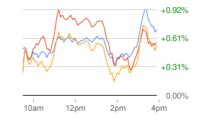
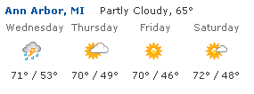
RL: Optimizing Sequential Decisions Under Uncertainty
observations
actions

Slide 5
Classic Formalism
Given:
  A state space
  An action space
  A reward function
  Model information (ranges from full to nothing)
Find:
  A policy (a mapping from states to actions)
Such that:
  A reward-based metric is maximized

Slide 6
Reinforcement Learning
RL = learning meets planning

Slide 7
Reinforcement Learning
RL = learning meets planning
Logistics and scheduling
Acrobatic helicopters
Load balancing
Robot soccer
Bipedal locomotion
Dialogue systems
Game playing
Power grid control
…

Slide 8
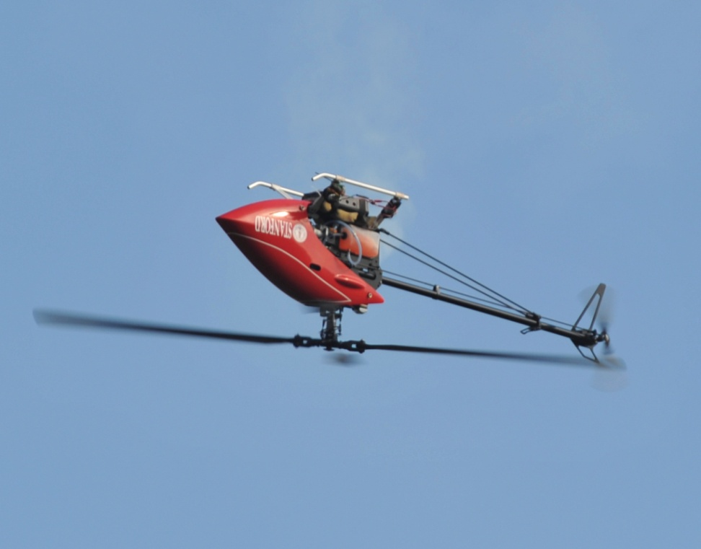
Reinforcement Learning
RL = learning meets planning
Logistics and scheduling
Acrobatic helicopters
Load balancing
Robot soccer
Bipedal locomotion
Dialogue systems
Game playing
Power grid control
…
Model: Pieter Abbeel. Apprenticeship Learning and Reinforcement Learning with Application to Robotic Control. PhD Thesis, 2008.

Slide 9
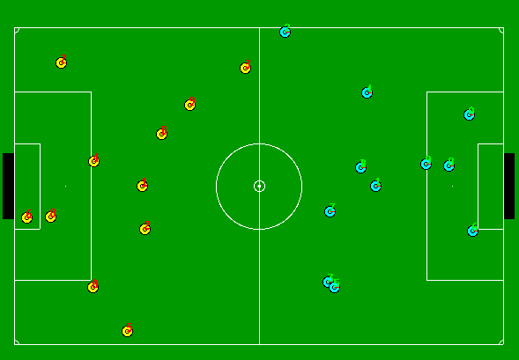
Reinforcement Learning
RL = learning meets planning
Logistics and scheduling
Acrobatic helicopters
Load balancing
Robot soccer
Bipedal locomotion
Dialogue systems
Game playing
Power grid control
…
Model: Peter Stone, Richard Sutton, Gregory Kuhlmann. Reinforcement Learning for RoboCup Soccer Keepaway. Adaptive Behavior, Vol. 13, No. 3, 2005

Slide 10
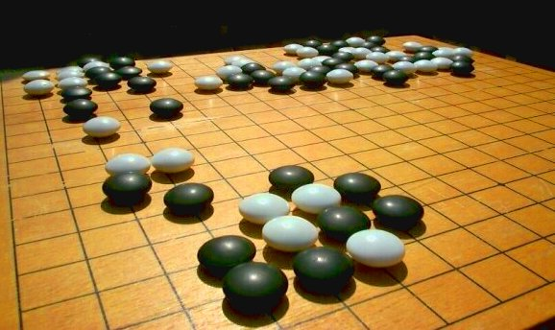
Reinforcement Learning
RL = learning meets planning
Logistics and scheduling
Acrobatic helicopters
Load balancing
Robot soccer
Bipedal locomotion
Dialogue systems
Game playing
Power grid control
…
Model: David Silver, Richard Sutton and Martin Muller. Sample-based learning and search with permanent and transient memories. ICML 2008

Slide 11
Types of RL
You can slice and dice RL many ways:
By problem setting
  Fully vs. partially observed
  Continuous or discrete
  Deterministic vs. stochastic
  Episodic vs. sequential
  Stationary vs. non-stationary
  Flat vs. factored
By optimization objective
  Average reward
  Infinite horizon (expected discounted reward)
By solution approach
  Model-free vs. Model-based (Q-learning, Bayesian RL, …)
  Online vs. batch
  Value function-based vs. policy search
  Dynamic programming, Monte-Carlo, TD

Slide 12
Fundamental Questions
Exploration vs. exploitation
On-policy vs. off-policy learning
Generalization
  Selecting the right representations
  Features for function approximators
Sample and computational complexity

Slide 13
RL vs. Optimal Control vs. Classical Planning
You probably want to use RL if
  You need to learn something on-line about your system.
    You don’t have a model of the system
    There are things you simply cannot predict
  Classic planning is too complex / expensive
    You have a model, but it’s intractable to plan
You probably want to use optimal control if
  Things are mathematically tidy
    You have a well-defined model and objective
    Your model is analytically tractable
    Ex.: holonomic PID; linear-quadratic regulator
You probably want to use classical planning if
  You have a model (probably deterministic)
  You’re dealing with a highly structured environment
    Symbolic; STRIPS, etc.

Slide 14
RL for Complex Systems

Slide 15
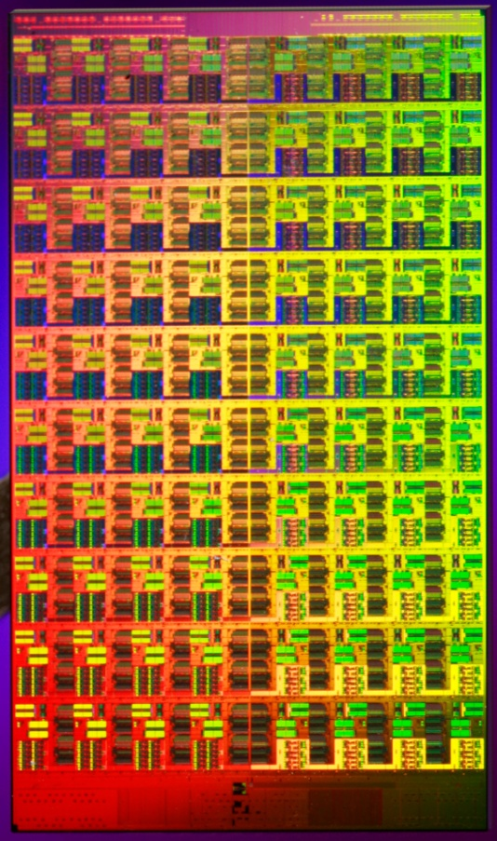
Smartlocks
A future multicore scenario
  It’s the year 2018
  Intel is running a 15nm process
  CPUs have hundreds of cores
There are many sources of asymmetry
  Cores regularly overheat
  Manufacturing defects result in different frequencies
  Nonuniform access to memory controllers
How can a programmer take full advantage of this hardware?
One answer: let machine learning help manage complexity

Slide 16
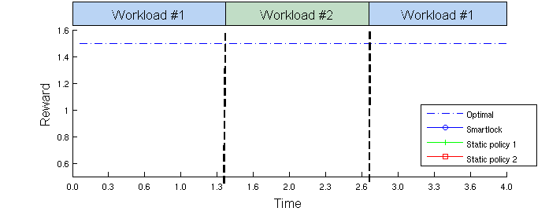
Smartlocks
A mutex combined with a reinforcement learning agent
Learns to resolve contention by adaptively prioritizing lock acquisition

Slide 17
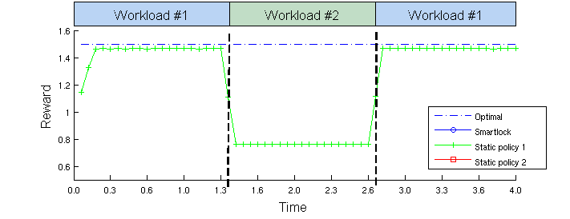
Smartlocks
A mutex combined with a reinforcement learning agent
Learns to resolve contention by adaptively prioritizing lock acquisition

Slide 18
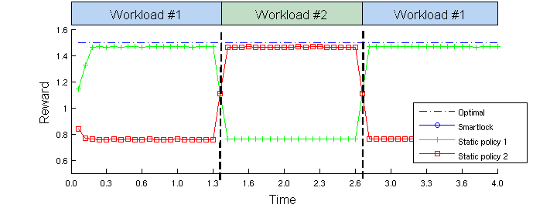
Smartlocks
A mutex combined with a reinforcement learning agent
Learns to resolve contention by adaptively prioritizing lock acquisition

Slide 19
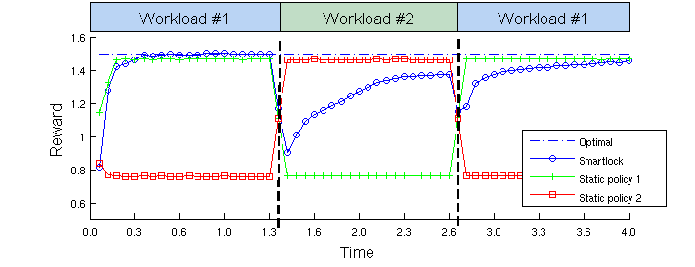
Smartlocks
A mutex combined with a reinforcement learning agent
Learns to resolve contention by adaptively prioritizing lock acquisition

Slide 20
Details
Model-free
Policy search via policy gradients
Objective function: heartbeats / second
ML engine runs in an additional thread
Typical operations: simple linear algebra
  Compute bound, not memory bound

Slide 21
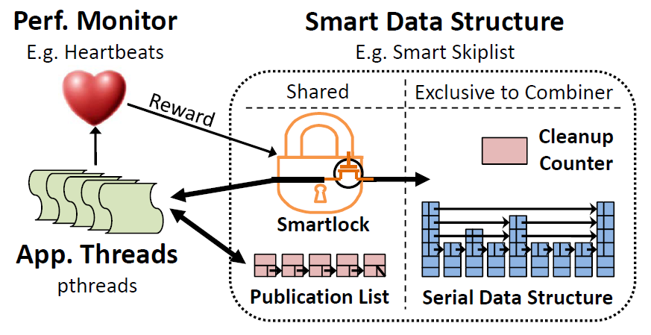
Smart Data Structures

Slide 22
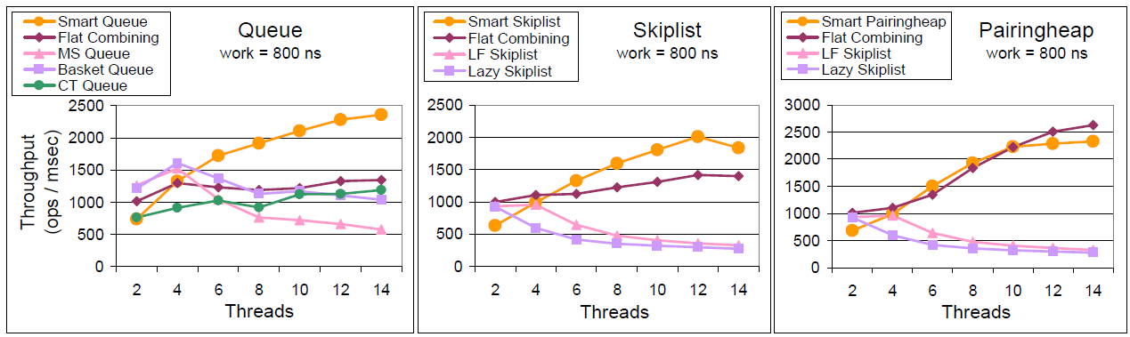
Results

Slide 23
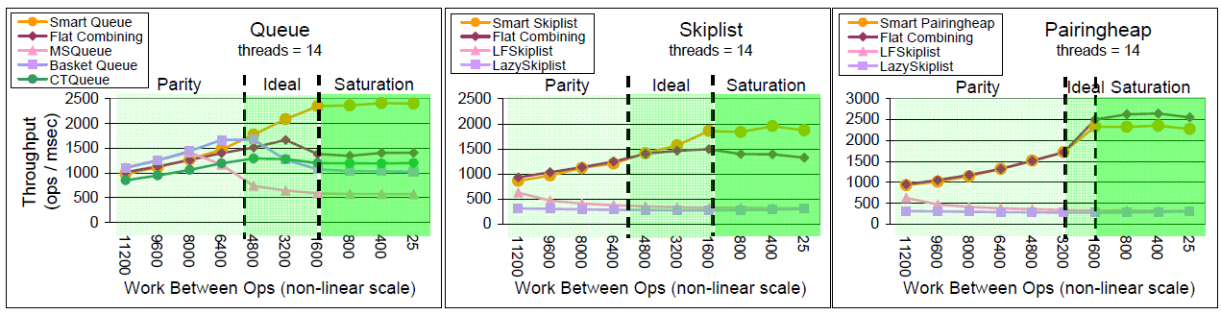
Results

Slide 24
Extensions?
Combine with model-building?
  Bayesian RL?
Could replace mutexes in different places to derive smart versions of
  Scheduler
  Disk controller
  DRAM controller
  Network controller
More abstract, too
  Data structures
  Code sequences?

Slide 25
More General ML/RL?
General ML for optimization of tunable knobs in any algorithm
  Preliminary experiments with smart data structures
  Passcount tuning for flat-combining – a big win!
What might hardware support look like?
  ML coprocessor? Tuned for policy gradients? Model building? Probabilistic modeling?
Expose accelerated ML/RL API as a low-level system service?

Slide 26
Thank you!

Slide 27
Bayesian RL
Use Hierarchical Bayesian methods to
learn a rich model of the world
while using planning to
figure out what to do with it

Slide 28
Bayesian Modeling

Slide 29
What is Bayesian Modeling?
Find structure in data
while dealing explicitly with uncertainty
The goal of a Bayesian is to reason about the distribution of structure in data

Slide 30
Example
What line generated this data?
That one?
This one?
What about this one?
Probably not this one

Slide 31

What About the “Bayes” Part?
Bayes Law is a mathematical fact that helps us
Likelihood
Prior

Slide 32
Distributions Over Structure
Visual perception
Natural language
Speech recognition
Topic understanding
Word learning
Causal relationships
Modeling relationships
Intuitive theories
…

Slide 33
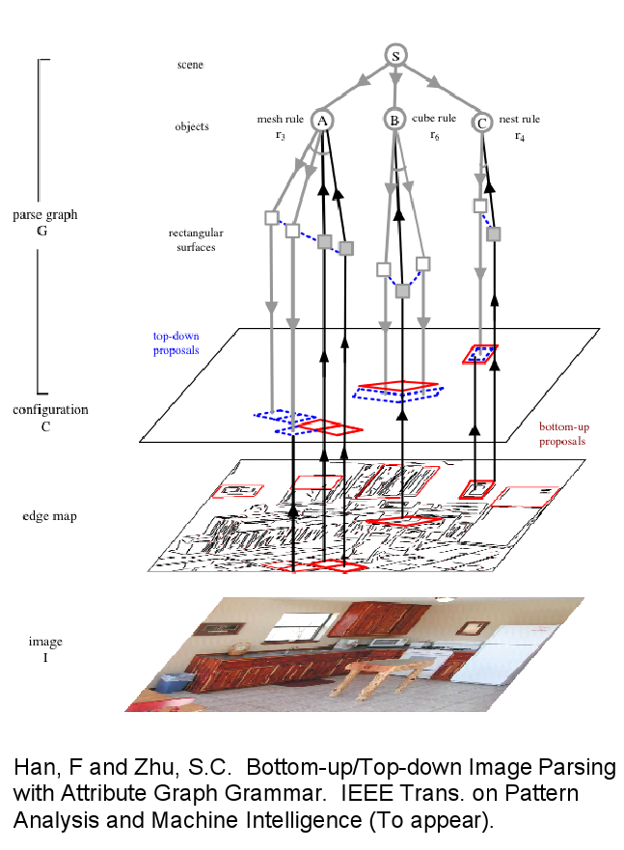
Distributions Over Structure
Visual perception
Natural language
Speech recognition
Topic understanding
Word learning
Causal relationships
Modeling relationships
Intuitive theories
…

Slide 34
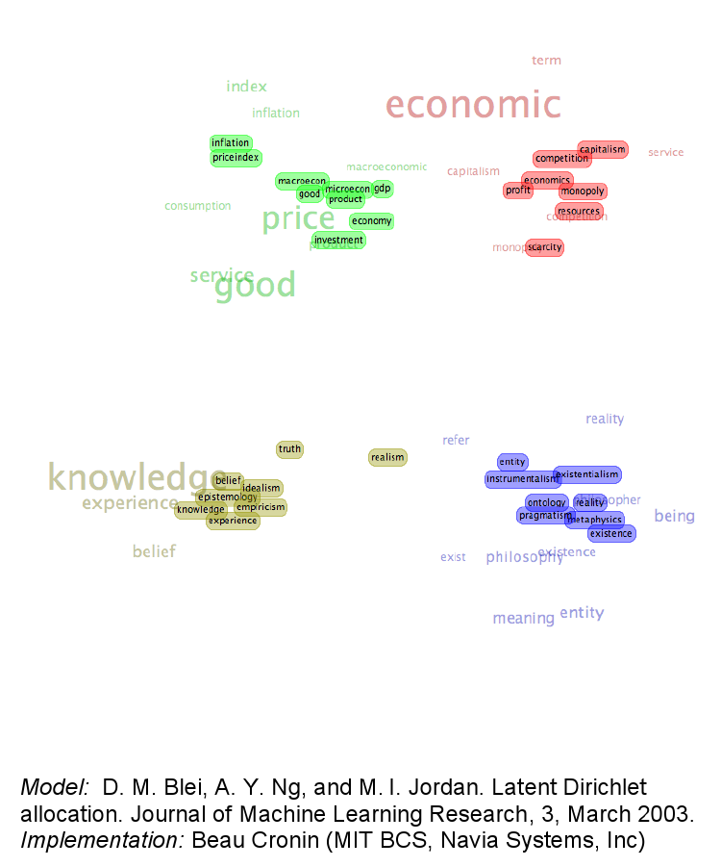
Distributions Over Structure
Visual perception
Natural language
Speech recognition
Topic understanding
Word learning
Causal relationships
Modeling relationships
Intuitive theories
…

Slide 35
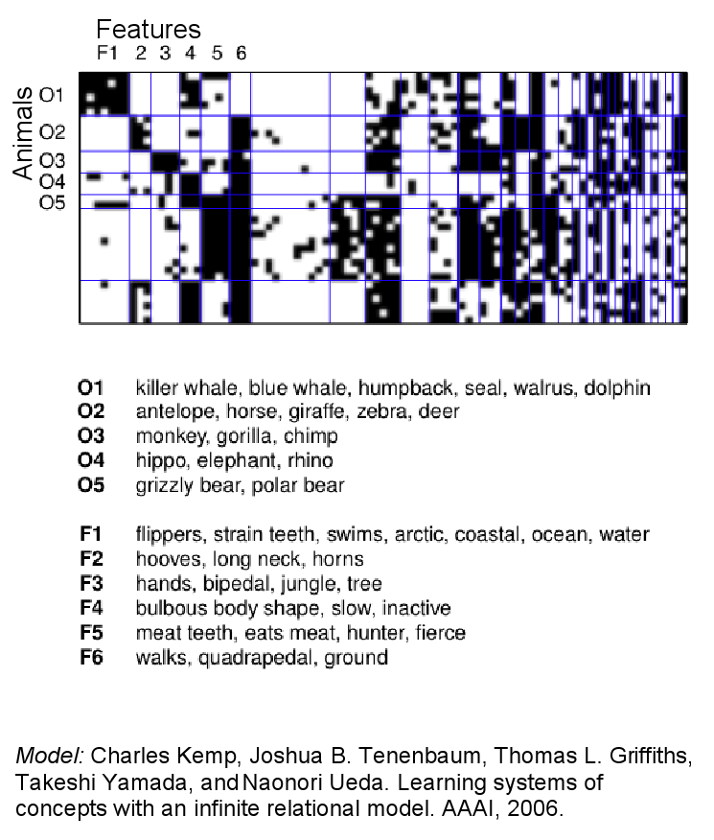
Distributions Over Structure
Visual perception
Natural language
Speech recognition
Topic understanding
Word learning
Causal relationships
Modeling relationships
Intuitive theories
…

Slide 36
Inference
So, we’ve defined these distributions mathematically.
What can we do with them?
Some questions we can ask:
  Compute an expected value
  Find the MAP value
  Compute the marginal likelihood
  Draw a sample from the distribution
All of these are computationally hard

