Slide 1
A Framework for Automatically Enforcing Privacy Policies
Jean Yang
MSRC / October 15, 2013
Notes:
Hello, my name is Jean Yang. Today, I am going talk about how to make it easier for programmers to enforce privacy policies.
TRANSITION: Privacy matters in the real world more and more as we’re putting more data online.

Slide 2
Privacy matters. People get it wrong.
Notes:
What’s more is that people often get it wrong.
Even Facebook, with privacy being so core to their model and with all of their programmer resources, has a leak every now and then. Here’s an example.
TRANSITION: It’s not surprising that programmers get this wrong.

Slide 3
Many possible points of failure.
Desired Policy
Implementation
Policy
Only friends can see GPS location.
getLocation(user)
Policy
findAllUsers(location)
Policy
findTopLocations()
Notes:
First of all, there are many points of failure.
Let’s consider what has to happen to enforce a policy that only my friends can see my GPS location.
We, the programmer has to enforce this policy at all points where the location is used. Not just in the function that gets a user’s location, but in functions that find all users at some given location or the most popular locations among users.
TRANSITION: What’s worse is that the policies are getting more complex.

Slide 4
Increasingly complex policies.
Desired Policy
Only friends can see GPS location.
who are local
within next five hours
Notes:
For instance, we could have a policy that says only friends who are local can see my GPS location within the next five hours.
TRANSITION: Some people might say that developer education solve this problem.

Slide 5
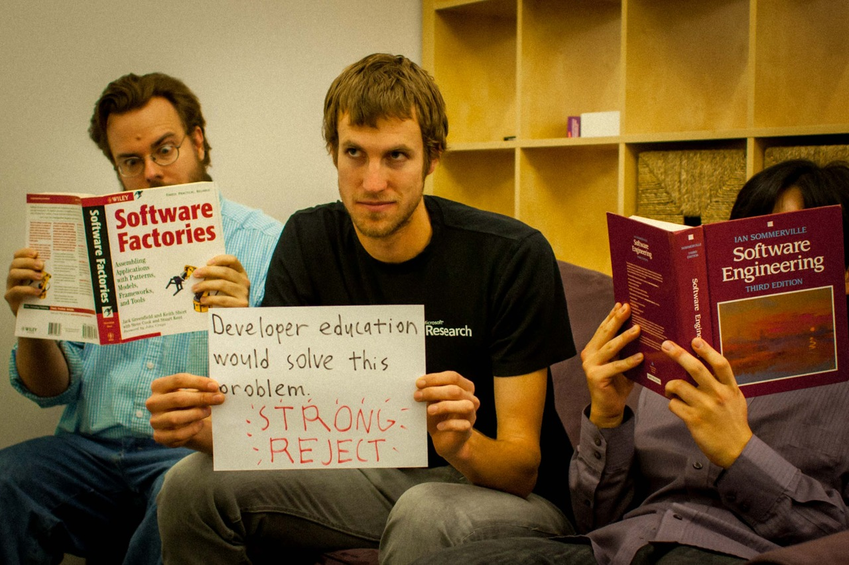
Notes:
But the thing is, developers know how to enforce policies.
The problem is that they have to enforce the same policy over and over again across the program. And if there’s one thing we know in software engineering, it’s that is error-prone.
TRANSITION: Let’s think a little bit about how to fix this.

Slide 6
Easier if we separate policies from other functionality.
Policy Implementation
Other Implementation
Only friends can see GPS location.
getLocation(user)
findAllUsers(location)
findTopLocations()
Notes:
If we only have to worry about the policy and nothing else, it’s not that complicated.
Similarly, if we only had to worry about the other functionality without the policies, it’s also much simpler.
Now what we need is a way to put the policies back together with the functionality to get the right results.
A tricky part, though, is that handling sensitive values through computations involves integrating with the language semantics.
But the policies are attached to data and not to code, so to enforce these policies in functions computing on the data we need to have a way of integrating with the language semantics.
TRANSITION: Because of this information flow issue, we propose a language-level approach.

Slide 7
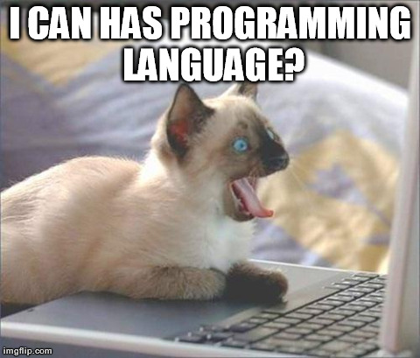
Notes:
In this talk, I’ll be describing a language and framework for automatically enforcing these privacy policies.

Slide 8
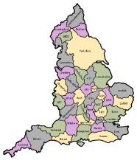
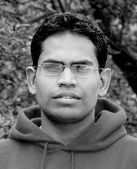
The Jeeves Language
⟨ | ⟩
k
Associated with
policies.
findAllUsers(MSRC)
You have no friends in this location.
Notes:
I’ve been working on the Jeeves programming language.
The key idea in Jeeves is that the programmer can define different views of a piece of data and rely on the runtime to use the appropriate view for the situation.
[Be more concrete before animating things in.]
Important that people can see a version of the data that does not violate the policies.
These views are associated with a label, to which the programmer may attach policies. The policies can talk about program values and the output channel.
The programs can be policy-agnostic, which means that the programmer does not have to know what the specific policies are.
The runtime simultaneously executes the program on the different views and shows different results to different viewers based on the permissions.
When Andrey, my host, tries to see who is at Microsoft Research Cambridge, he might see that his coworker Byron and I are here.
When my groupmate Rishabh tries to perform the same search, he may see that nobody is there.
TRANSITION: Let us now look more specifically at Jeeves syntax.

Slide 9
Sensitive Values
{ low, high }
label a
val loc = ⟨gpsCoords | country(gpsCoords)⟩_{a}
High value.
Low value.
Label.
Policies
restrict a: λoc.(isNear(oc, jean))
Label.
Output channel.
Predicate.
Core Functionality
val msg = “Jean’s location is ” + asStr(loc)
Contextual Enforcement
print {andrey} msg “Jean’s location is N 52.19°, W 0.13°.”
print {rishabh} msg “Jean’s location is in the United Kingdom.”
Notes:
First, the programmer can make labels that may be associated with sensitive values.
Sensitive values have a high-confidentiality facet and a low-confidentiality facet, guarded by the label.
If the label’s value is high, then the value acts as the high-confidentiality facet. Otherwise, the value acts as the low-confidentiality facet.
The runtime assigns values to the labels based on policies that the programmer provides.
Policies take a label and a function describing restrictions on the label. The function takes an output channel and returns a predicate determining when the label is allowed to be high.
The Jeeves runtime collects these policies to determine which views of sensitive values should be shown.
The Jeeves programmer can use sensitive interchangeably with other values.
For instance, here we create a string “msg” that is the concatenation of the sensitive location with the string “Alice is at.”
Effectful computations such as print require a context to determine what the output should be.
To evaluate this, the runtime finds an assignment for the labels that satisfies the policies and then uses this assignment to project out the appropriate result.
Printing in the context of user alice should yield the string “Alice is at MIT,” while printing on the context of user bob should yield the string “Alice is at school.”
** QUESTIONS? ***
TRANSITION: Let’s take a closer look at policies.

Slide 10
Jeeves Execution
Storing policies
Faceted execution
label a
=
restrict a: λoc.true
⟨3 | 0⟩ _{a}
3
Policies
a → λoc.true
⟨true | false⟩ _{a}
Constraints
print {…} …
true ⇒ a = low
false
Notes:
To evaluate sensitive values, the runtime performs faceted execution, evaluating the high and low facets and putting the results back together.
The runtime also handles implicit flows by evaluating both sides of a conditional.
After evaluation, we get trees of faceted values, where each facet is guarded by a label.
Policies determine the values of the labels.
The runtime stores mappings of labels to policies in order to eventually assign values to the labels.
Once the runtime gets an output channel, it creates a system of constraints from the labels in order to find a satisfying assignment.
Once it gets a satisfying assignment to the labels, the runtime projects values out of the facets in order to produce the value to output.
*** QUESTIONS? ***
TRANSITION: You may now be wondering…

Slide 11
Jeeves Policies
restrict a: λoc.isNear(oc,me)
λoc.addConstraint(¬ isNear(oc, me) ⇒ a == low)
Policies may refer to sensitive values.
Constraints always take this form.
Notes
There is always a consistent assignment.
Notion of maximal functionality: if a label is allowed to be high, we try to set it to high.
Notes:
Let’s now take a closer look at the policies.
Restrict creates a function that takes an output channel as an argument and adds a constraint that says if the predicate is _not_ true, the label must be low.
The first thing to note is that policies may refer to sensitive values.
Additionally, the constraints all take the form of requiring a label to be low.
Because of this, the constraint environment is always consistent: assigning everything to low is always consistent.
Especially to handle the circular dependencies that may arise between policies and sensitive values, we have this notion of maximal functionality: labels are set to high unless policies require them to be low.
TRANSITION: The Jeeves runtime uses these policies to project out the appropriate result facet for the viewer.

Slide 12
Notes:
What is the theorem? What are the guarantees more formally?
TRANSITION: Before we look at Jeeves, let’s look at what you might be expecting from classical information flow.

Slide 13
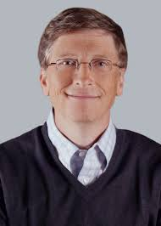
Classical Security
Lattice of access levels.
Level 3:
top secret.
Level 2:
highly classified.
Level 1:
privileged information.
Notes:
In classical security, people typically define a lattice of access levels.
A higher access level corresponds to a higher security level. For instance…
TRANSITION: To view an output, the viewer must have an access level corresponding to the highest level of any value used to compute the output.

Slide 14
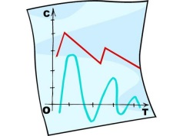
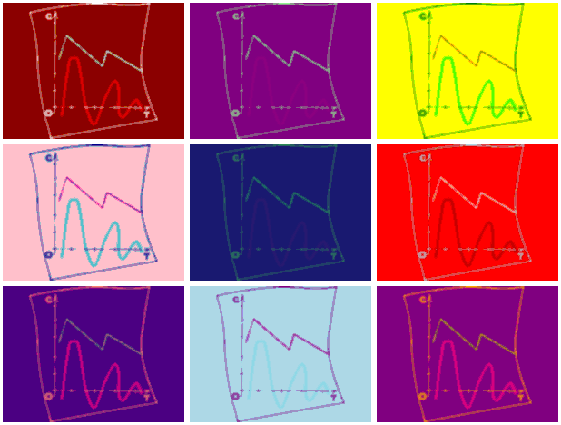
Classical Security
+
Level 3
Level 0
Level 3
Viewers must have access for the highest level.
Notes:
In this model of classical information flow, the access level of a value is the highest level of the values that were used to compute it.
For instance, if we took this classified information and combined it with this Andy Warhol painting to make an Andy Warhol classified information, only the NSA could see it.
The program would not produce any results for anyone else.
TRANSITION: Jeeves is different in that the program always produces results.

Slide 15
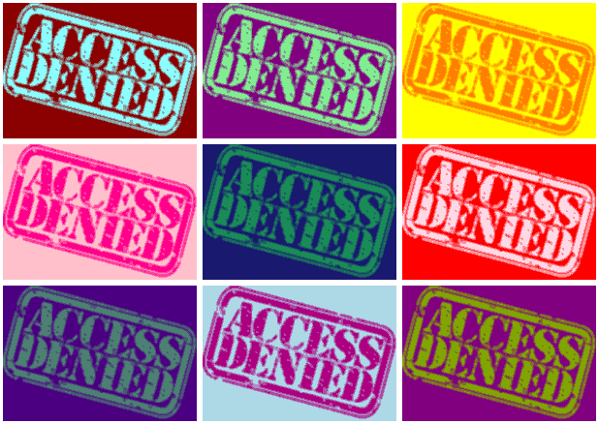
Jeeves Security
⟨ | ⟩
+
p
Notes:
In Jeeves, the property is not whether the viewer can see an output, but what output the viewer can see.
Instead of associating a value with an access level, the programmer provides a different value for different access levels.
When anyone except for the NSA tries to view the top secret information, they get to see an Andy Warholed version of “Access Denied.”
TRANSITION: Thus the non-interference guarantee in Jeeves talks about which value is output rather than the access level of the outputs.

Slide 16
Jeeves Non-Interference Guarantee
Given a sensitive value
Takes into account when label depends on sensitive values!
⟨ H | L ⟩_{a}
all executions where a must be low produce equivalent outputs no matter the value of H.
Notes:
We have the following non-interference guarantee for Jeeves.
Traditional info flow too strong for the kinds of policies we want to write.
Given a fixed value for the low component, all executions where the level variable must be low produce equivalent outputs no matter what the value of H is.
This guarantee is different than classical non-interference because the dependencies of policies on sensitive values inherently leak some information.
TRANSITION: Let me illustrate how our guarantee captures what can be revealed.

Slide 17
Non-Interference in Jeeves
restrict a: λoc.(distance(oc, location) < 25)
protected location
Viewer within radius:
a is allowed to be high.
viewer
Notes:
Recall the policy that someone can see my actual location if they are near me. This policy depends on the sensitive location.
If the viewer is within the appropriate radius of my location, then the label can be high and they can see the high value.
In this case, the high-confidentiality facet affects the value of the label and flows to the output.

Slide 18
Non-Interference in Jeeves
restrict a: λoc.(distance(oc, location) < 25)
Viewer outside radius:
a must be low.
Viewer should not be able to distinguish actual location from any other of these points.
viewer
protected location
Notes:
If the viewer is outside the radius, then label a must be low. When label a is low, the viewer knows that the high value is outside the radius, but it should not be able to distinguish the actual location from any of the other locations outside the points.
And so we guarantee that high values only flow to viewers to the degree that the policies allow.
TRANSITION: We’ve implemented a real system with these guarantees.

Slide 20
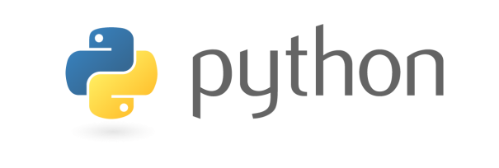
Implementation
Overload operators for faceted evaluation.
Store policies in runtime environment
=
mkLabel
restrict
⟨3 | 42⟩ _{a}
3
Policy environment
⟨true | false⟩ _{a}
Use an SMT solver as a model finder.
print
false
Notes:
We have implementations in both Scala and Python.
In the implementations, we overload operators for faceted evaluation. We store policies in the runtime environment.
We use the Z3 SMT solver to find a satisfying assignment to the labels and then we project out the appropriate facet based on the label assignments.
TRANSITION: We have been looking at extending these runtime implementations into web frameworks.

Slide 21
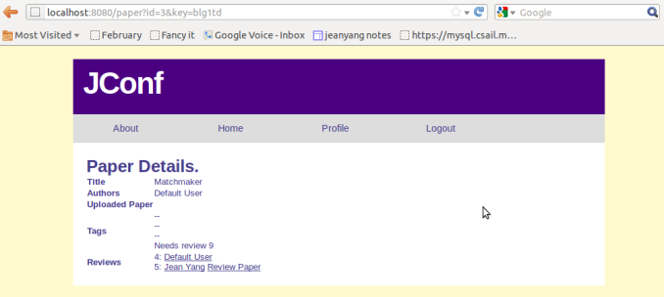
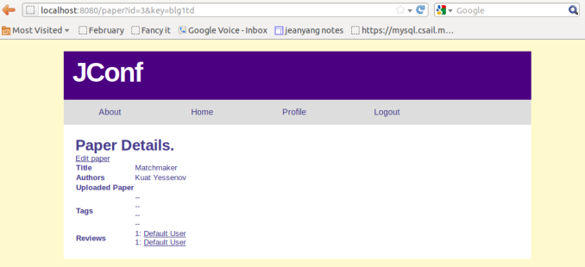
Case study: JConf
JConf policies
JConf functionality
Reviewer
Author

Slide 22
Jconf Architecture
Paper
Title
Author
Reviews
Tags
…
Review
Reviewer
Content
Policy
Policy
Policy
Policy
Policy
Policy
User
Role
Policy
Context
User
Stage
Core Program
Search papers.
Display papers.
Add and remove tags.
Assign and submit reviews.
Functionality
Notes:
Policies are associated with fields of papers, reviews, and users.
TRANSITION: We have integrated this backend with an end-to-end system where we use Jeeves policies for both confidentiality and integrity.

Slide 23
Functionality vs. Policy
File | Total LOC | Policy LOC
ConfUser.scala | 212 | 21
PaperRecord.scala | 304 | 75
PaperReview.scala | 116 | 32
ConfContext.scala | 6 | 0
Backend + Squeryl | 800 | 0
Frontend (Scalatra) | 629 | 0
Frontend (SSP) | 798 | 0
Total | 2865 | 128
< 5%

Slide 24
Jeeves Frameworks
Scalatra frontend
Embedded DSL
SQL
(Squeryl)
Python-Jeeves
source transform
Django frontend
Embedded DSL
PostGre
SQL
Notes:
We built the conference management system using our embedded domain-specific language in Scala.
Scala’s type system made it nice to check various properties of programs statically.
We extended this to a web framework using Scalatra in the frontend and interfacing with a SQL database through Squeryl.
[Talk about why we switched to Python.]
TRANSITION: We are currently looking at various aspects of creating a Jeeves web framework.

Slide 25
What about inputs?
---
Reviews
Author
New review
New review
Reviewer A
Reviewer B
Notes:
Let’s think about what happens when we want to make sure inputs in our system behave.
Consider the conference management system, where we have reviewers adding new reviews to the system.
We can easily use the confidentiality policies to enforce that other reviewers can see updates to a review, while the paper authors cannot.
TRANSITION: In fact, facets also allow us to easily store multiple versions of information.

Slide 26
Storing multiple versions?
Old review
Reviews
Author
New review
New review
Reviewer A
Reviewer B
Notes:
For instance, we can also use facets to freeze review updates during the rebuttal phase so that other reviewers can see review updates but authors can still see the old review.
Facets make it easy to store multiple versions of a value guarded by some policy.
TRANSITION: Now let’s think about the case where which value a viewer sees depends not just on the viewer, but also the writer.

Slide 27
When viewers specify trust…
Need to additionally track who is writing…
---
Scores
User
Old score
New score
User
User
New score
User
Notes:
Suppose we have not reviews in a conference management system, but reviews in a shared review system such as Yelp or UrbanSpoon.
In a system like this, it would be great if viewers can specify what they see based on which input channel they trust.
If we could do this, then each viewer can specify whether they see the specific writes based on the writer and also other information concerning the input channel.
TRANSITION: We can support this by extending the Jeeves model with a way to handle input channels as well as output channels.

Slide 28
Low-level mechanism
Mutable State
42
p₁
Associate references with policies
42
p₂
42
p₂
wrestrict λin.λout.(isFriends(in, alice))
wrestrict λin.λout.
((in == alice) && isFriends (out, alice))
Notes:
We can track writes into the system by associating policies with mutable references.
We have extended Jeeves with write policies, which are functions that take an input channel as well as an output channel. These policies now talk about the writer as well as the reader. The runtime system applies the first argument whenever there is a write and creates a new facet to store the update.
TRANSITION: Because we are using facets to keep track of writes, we can easily extend our confidentiality guarantees.

Slide 29
Guarantees
New score
Execution with writer’s inputs
Execution without writer’s inputs
Notes:
Whenever there is a new write, we essentially simultaneously execute with and without the new writes without the executions affect each other.
And we can enforce these write policies without violating confidentiality guarantees.
TRANSITION: We’ve also been looking at how these works in practice.

Slide 30
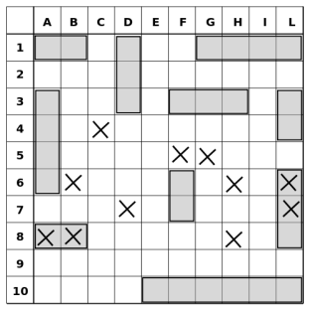
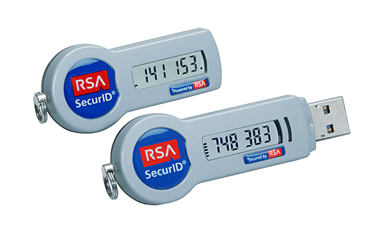
Write Policy Case Studies
Authentication
Conference management
Battleship game
Notes
Support policies for confidentiality and integrity.
Policy-agnosticism good for encoding other policies, for instance game rules.
Notes:
We implemented a few case studies: password-based authentication, our conference management system, and a battleship game in which two players place ships on a secret board and disclose the locations of ships only when the opponent has bombed the ship.
Through this, we found that write policies are useful for supporting policies for both confidentiality and integrity in a system where there are updates to the state.
Through making the battleship game, we also learned that this policy-agnostic approach allows for an implementation approach that allows the programmer to simplify game rules from functionality such as displaying the game board and storing player moves. These game rules are policies that depend on program state in addition to the identity of who is reading and writing.
TRANSITION:

Slide 31
Interfacing with the DB
select * from papers
where author = “Jean Yang”
author_{high}
author_{low}
policies
⟨ | ⟩
p
Notes:
Optimizations:
Fetching only what we need from the database.
Delaying queries until context is known.
Using knowledge of data values to minimize query output (for instance, for “order by.”)

Slide 32
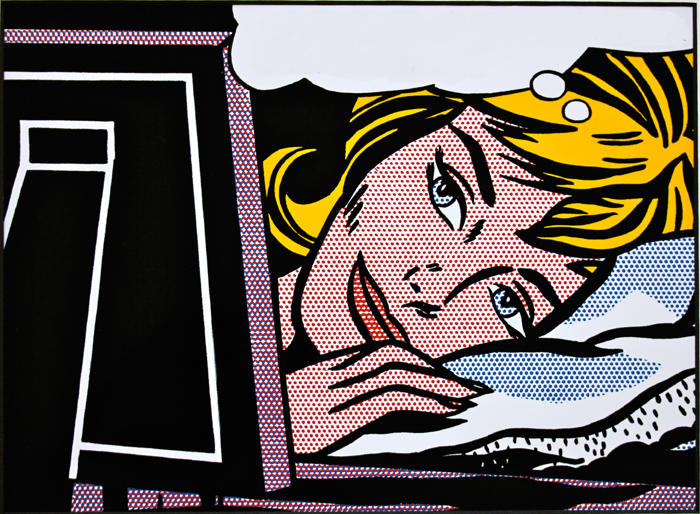
FINALLY.. I CAN FOCUS ON FUNCTIONALITY!
Notes:
This allows the programmer to focus on program functionality, resting assured that the Jeeves system is correctly enforcing the policies.

Slide 33
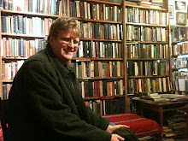
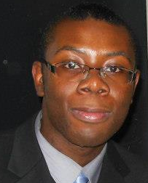
Jeeves Team
Armando Solar-Lezama
Travis
Hance
Cormac Flanagan
Thomas Austin
Benjamin
Shaibu

Slide 34
The Jeeves Framework
jeeveslang.org
⟨ | ⟩
k
Program
Customized page
Customized page
Notes:
In this talk, I have described how we are building towards a web framework for automatically enforcing privacy policies.
Programmer can specify different views of sensitive values.
The system is responsible for displaying different values to different people.
It is exciting that language technology allows us to think about automating global concerns such as informational flow policies. I am looking forward to thinking about what other ways we can make programmers’ lives easier.

